Slide 1

Introduction begin here…
Get linked with a world of infinite opportunities
Notes:
INTRODUCTION page 🡪 “All Content is editable
For edit Footer or visible content you must getting to the Master Slide -> click “VIEW” tab -> in the “Master Views” group, click “Slide Master”. (–and- or you can changeyour logo on there”)

Slide 2
SAN eForce
SAN FMCG Services
Providing SFE Services to FMCG, Pharmaceuticals and Healthcare
100,000+ Users
15+ Years of Service
10+ Countries
.
Division of SAN Media Ltd
San Media Limited was incorporated in the year 1992. It is a Public Limited company with its headquarters located in India.
Notes:
CEO Flow🡪 “All Content is editable
How Edit/Fill Shape Color -> “Right Click” on the Object, select “Format Shape”, choose “Fill” a color from color pallete (bucket icon-on the right side on New Powerpoint)
How to Group an Object/Shape -> “Right Click” on the Object (More than 1), select “Group” > “Group”
How to Ungroup an Object/Shape -> “Right Click” on the Object, select “Group” > “Ungroup”

Slide 3

SAN FMCG Services
SAN FMCG is an integrated automation tool by which organisations can do better manage their distribution of products to different outlets as well as assist in the improved management of the workforce. SAN FMCG provides the ideal solution that records all the stages in a sales process. It tracks all stages like Retail, Sales, Purchase, Warehouse and Distributor Inventory Management.
Notes:
CEO Flow 🡪 “All Content is editable
How Edit/Fill Shape Color -> “Right Click” on the Object, select “Format Shape”, choose “Fill” a color from color pallete (bucket icon-on the right side on New Powerpoint)
How to Group an Object/Shape -> “Right Click” on the Object (More than 1), select “Group” > “Group”
How to Ungroup an Object/Shape -> “Right Click” on the Object, select “Group” > “Ungroup”

Slide 4
SAN eForce Attendance system
01
My day Plan in the morning for Attendance and report.
02
Verify the location from HO.
03
Commencement of work time.
04
Time Elapsed at each Outlets
05
Number of hours worked in a day
Notes:
Department of Commerce🡪 “All Content is editable
How to Group an Object/Shape -> “Right Click” on the Object (More than 1), select “Group” > “Group”
How to Ungroup an Object/Shape -> “Right Click” on the Object, select “Group” > “Ungroup”

Slide 5
SAN eForce Modules & Features
Salesman Performance Management
Collections and Customer Ledger
Retail effectiveness and Turn over
Primary capture from Distributors and
conversion of Order To Primary sales
ABC of Retail , Product and
Distributor Performance
MIS Reports for all KPI With Graphical
Indicators
Order conversion to secondary
sales
Inventory Management at the
Warehouse And Distributor
Ready Stock Sales & Invoicing
Dynamic Dashboards for Specific areas
of performance
** Construction
Notes:
Body Anatomy 🡪 “All Content is editable
How Edit/Fill Shape Color -> “Right Click” on the Object, select “Format Shape”, choose “Fill” a color from color pallete (bucket icon-on the right side on New Powerpoint)
How to Group an Object/Shape -> “Right Click” on the Object (More than 1), select “Group” > “Group”
How to Ungroup an Object/Shape -> “Right Click” on the Object, select “Group” > “Ungroup”

Slide 6
Retail
Universe of Outlets for
every distributor split into Routes/Beats
ABC of Retail Turnover
Classified Retail Outlets
Promotion effectiveness in a retail channel
New Outlets added
each week
Retailer Purchase Pattern
Products without Sales for a specific
frequency of time
Retailer Purchase Pattern for a period of time
Outlets that are not buying
from the company distributors (Lost Outlets)
Products Purchased – ABC analysis
(80 % contributing products)

Slide 7

Distributors
Purchase
Retailing
Purchase Trends in Value
Placement of products in retail
Purchase as per targets
Orders from Maximum outlets
ABC of Product Purchased
Original Order Capture
Lost Products
Distribution width of Products
Notes:
Affinity Diagrams 🡪 “All Content is editable
How Edit/Fill Shape Color -> “Right Click” on the Object, select “Format Shape”, choose “Fill” a color from color pallete (bucket icon-on the right side on New Powerpoint)
How to Group an Object/Shape -> “Right Click” on the Object (More than 1), select “Group” > “Group”
How to Ungroup an Object/Shape -> “Right Click” on the Object, select “Group” > “Ungroup”

Slide 8
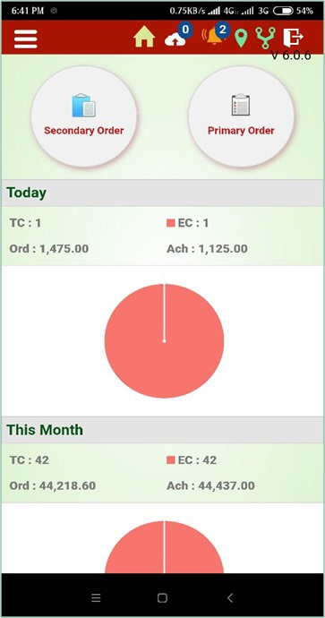
Mobile App
With SAN FMCG Mobile app field force can instantly submit their
Tour Plan, Daily Activity, Attendance and convert order to invoice.
Other Unique Features are
Both Online & Offline Reporting
Primary/Secondary Order Booking
Target Vs Achievement Dashboards
Tracking of Precise location
Notes:
Mockup Page🡪 “All Content is editable
For add the image -> Just click “Click icon to add picture ” and choose your great picture and click “insert”
Edit SmartChart -> “Right Click” on the Chart -> click “Edit Data” , and you can change the data
How to Group an Object/Shape -> “Right Click” on the Object (More than 1), select “Group” > “Group”
How to Ungroup an Object/Shape -> “Right Click” on the Object, select “Group” > “Ungroup”

Slide 9
Salesman Call Tracking
Sales Reports
Location Finder
DCR Monitering reports
Target vs Acheivement
Target Fixation
View
SAN eForce MIS Reports
Target vs Sales
DCR Analysis
Field Force Analysis
Product wise call feedback
Visit Analysis
MIS Reports
Customer wise sales Analysis
Functional Reports
Performance and operations of field activities done by medical reps can be viewed in real-time through MIS Reports, analytics, reports, notifications and alerts, on mobile devices by managers to take instant corrective action.
Retail Analysis
Product wise sales Analysis
Employee wise order details
Attendance report
Activity Reports
Retail Visit Status
Secondary Order
Primary Order
SKU Analysis
Performance
Reports
Distributor Performance
Product Cat Analysis
New Outlet sales reports
Notes:
Decision Tree 🡪 “All Content is editable
How Edit/Fill Shape Color -> “Right Click” on the Object, select “Format Shape”, choose “Fill” a color from color pallete (bucket icon-on the right side on New Powerpoint)
How to Group an Object/Shape -> “Right Click” on the Object (More than 1), select “Group” > “Group”
How to Ungroup an Object/Shape -> “Right Click” on the Object, select “Group” > “Ungroup”

Slide 10
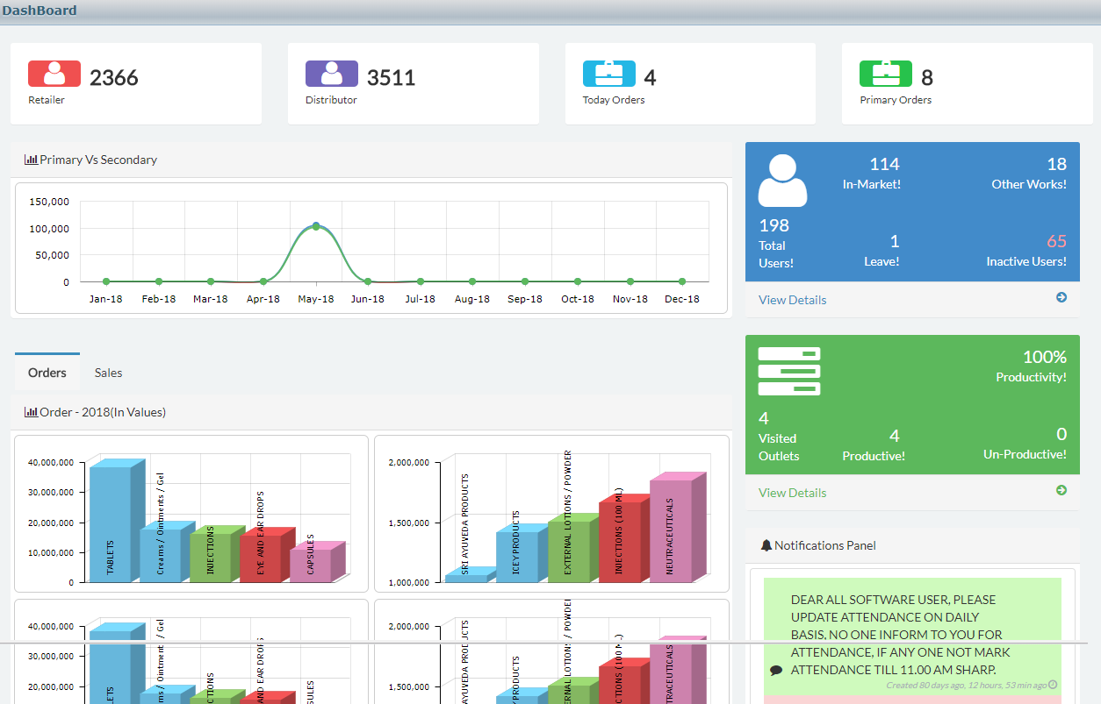

Slide 11
SAN eForce Implementation
Masters Data Upload
Implementation
03
01
Client needs to provide us with the Distributor
Details, retailer details along with the
Product details.
Our Service Team Ensures You Are
Supported Well After The Implementation
And Continually Developing New
Benefits Upon enhancing the product
with new modules. This Will Help
Improve Your Productivity.
Functional Discussion
02
SAN eFORCE Collaborates With Its Clients To Jointly
Develop An Implementation Project Plan. This Plan
Includes Details On How & When The Data Will Be Migrated
into the system with companies tailored requirements.
Notes:
Brainstorming Process 🡪 “All Content is editable
How Edit/Fill Shape Color -> “Right Click” on the Object, select “Format Shape”, choose “Fill” a color from color pallete (bucket icon-on the right side on New Powerpoint)
How to Group an Object/Shape -> “Right Click” on the Object (More than 1), select “Group” > “Group”
How to Ungroup an Object/Shape -> “Right Click” on the Object, select “Group” > “Ungroup”

Slide 12
SAN eForce Training
Result
SAN FMCG Training Services will train and mentor your staff to ensure they have the knowledge and skills to properly use, sustain, and evolve your deployed solution
06
04
Training to Field Force
Our Technical executives will train your field force for initial setup.
05
Training to Admin
Admin Training can be given either Online/Direct training to Monitor the Field Activities, upload data, Analyse the sales etc.
Notes:
Brainstorming Process 🡪 “All Content is editable
How Edit/Fill Shape Color -> “Right Click” on the Object, select “Format Shape”, choose “Fill” a color from color pallete (bucket icon-on the right side on New Powerpoint)
How to Group an Object/Shape -> “Right Click” on the Object (More than 1), select “Group” > “Group”
How to Ungroup an Object/Shape -> “Right Click” on the Object, select “Group” > “Ungroup”

Slide 13
Security Mechanism
APPLICATION SECURITY
DATABASE SECURITY
The application uses Form authentication technique to authenticate the users. Forms authentication lets you to authenticate users by using your own code and then maintain an authentication token in a cookie or in the page URL. The application also uses role based authorization techniques to authorize and allow users to their respective views based on the roles defined in the database.
The application also encompasses defense strategies that protects it from other security threats like SQL injection, Cross site scripting and Invalidated Redirects and Forwards.
The database security measures implemented in the
application include firewall protection,
SQL server authentication, auditing, encryption and database backup.
Firewall Security
The below mentioned firewall is used
for protecting the application environment
Cisco ASA 5510
Notes:
Security🡪 “All Content is editable
How Edit/Fill Shape Color -> “Right Click” on the Object, select “Format Shape”, choose “Fill” a color from color pallete (bucket icon-on the right side on New Powerpoint)
How to Group an Object/Shape -> “Right Click” on the Object (More than 1), select “Group” > “Group”
How to Ungroup an Object/Shape -> “Right Click” on the Object, select “Group” > “Ungroup”

Slide 14
Why us?
0
1
Standard Support
Support Forms The Backbone Of Automation. At SANeFORCE With Every Delivery, We Provide The Customer With Customer Portal. It Is An Online Support Where You Can Simply Raise A Ticket &We Promise To Revert &Attend The Query Within 2 Hours.
02
Easier implementations
Our professional services team makes sure your solution is deployed efficiently and that your users are equipped with industry best practices for quick adoption.
03
Quicker return on investment
Our team of experts gets you up and running quickly so you start reaping the benefits sooner.
04
Tailored solutions
Our transformation consulting team helps you discover and tailor a solution that’s exactly right for your business.
‹#›

Slide 15


`

